Slide 1

Module 4 DMS Project Requirements
David Winter Software Development 1 CEN-3024C 1/30/2025

Slide 2
Object Definition
Vehicle
Main object of interaction between users and administrators
User
Reservation
Main object where many end users will interact with the software to make vehicle rental reservations
Main object used for vehicle reservations. This will be used to track and assign all reservations to users.

Slide 3
Users
Attributes:
id: int
firstName: String
lastName: String
email: String
password: String
accountType: String (using values: user, admin
reservations: List<Reservation>

Slide 4
Vehicle
Attributes:
id: int
carType: String (using values: car, SUV, pickup truck)
model: String
year: int
milage: double
Reservations: List<Reservations> (track reservations)
pricePerDay: double

Slide 5
Reservation
Attributes:
id: int
userId: int (correspond to user’s unique id)
vehicleId: int (correspond to vehicle’s unique id)
pickupDate: Date
dropOffDate: Date
totalCharge: double

Slide 6

Functional Requirements

Slide 7
User Registration / Login
Users can register with personal information
Users can log in with their email and password
Restriction: During the later phases due to the GUI limitations the first administrator must be added to the database manually during the creation of the DMBs (MySQL, or SQLite in the future during phase 4)

Slide 8
User Account Management
Users can view and edit their account details
Users can change their password
User can delete their account

Slide 9
Brows Vehicle Selection
Users can filter vehicles based on type, capacity, transmission, and price range
Users can view vehicle details and availability after entering their reservation date

Slide 10
Reservation Management
Users can reserve vehicles for specified dates
Users can view their reserved vehicles
System will prevent double booking of vehicles
Users can delete their reservations

Slide 11
Admin Management
Admins can manage vehicle listings by adding and deleting vehicles
Admins can manage user accounts by adding and deleting users
Admins can view and manage vehicle reservations
Admins can edit and manage their own admin accounts

Slide 12

Non-Functional Requirements

Slide 13
Performance
The system should not crash regardless of how the application is being used. Exception handling will prevent this from
The system must be able to maintain 99% uptime using AWS cluster technology
The system must be able to scale its performance based on the number of active users to allow for smooth user experience

Slide 14
Usability
The command line interface should be easy to use and straight forward
The GUI will be sleek in design and simplistic

Slide 15
Compatibility
The system should be compatible with common operating systems such as Windows, macOS, and Linux
The system should handle any email domain during registration

Slide 16
Data Integrity
The system will prevent data duplication for email addresses and reservations as well as registered vehicles
The system should use data encryption to protect user information
The system should provide account confirmation if the user’s account is locked and in need of recovery

Slide 17

Data Storage Servers

Slide 18
Data Structure
For the initial phases 1 to 3 data will be stored in arrays. In the final phase 4 data will be stored in a DBMS and integrated with the GUI using JavaFX
User and vehicle data will be stored in separate arrays during early phases
Reservations will be managed through a list with their associated user also using arrays
CRUD functionality will rely on the DBMS’ data during phase 4

Slide 19
Data Retrieval
Users will be able to view their information through menu options using the CLI during phase 1 to 2.
Later data will be retrieved from the GUI in phase 3.
During phase 4 data will be retrieved from the DBMS using the GUI
Admins will retrieve information from vehicles, users, and reservations through a similar method

Slide 20

User Story

Slide 21
User Reserving a vehicle
As a registered user I want to reserve a vehicle for specific dates so that I can ensure it is available for my trip.
Input information
The user selects a vehicle type and provides pickup and drop off dates.
Check Availability
The system checks if the vehicle is available for the requested dates
If available the reservation is processed, if not the user is informed of the date conflict
Confirmation
After a successful reservation, the user receives confirmation and prompted to check their reservations tab
Error Handling
If the user tries to reserve a vehicle that is already booked the system informs the user of the conflicting dates

Slide 22
User Account Management
As a registered user I want to manage my account details so that I can keep my information up to date.
View Account Details
The user can view their account information including name, email, and reservation history
Edit Information
The user can edit their first name, last name and email address
The user can change their password
Delete Account
The user can delete their account

Slide 23
Administrator Vehicle Management
As an administrator I want to manage our vehicle listings so that I can ensure accurate information is available for users
View All Vehicles
The administrator can access a list of all vehicles in the system
Add Vehicle
The administrator can add a new vehicle by entering necessary details (model, year, price, etc.) or uploading a .txt file
Delete Vehicle
The administrator can delete a vehicle from the system, with confirmation required to prevent accidental deletions
Edit Vehicle Information
The administrator can edit existing vehicle details (e.g., change price or update availability)

Slide 24
Administrator User Management
As an administrator I want to manage user accounts so that I can maintain the integrity of the system
View All Users
The administrator can see a list of all registered users
Add User
The administrator can create new user accounts by entering fields in the DBMS or by uploading a .txt file
Delete User
The administrator can delete user accounts
Edit User Information
The administrator can edit user details and password

Slide 25
Administrator Reservation Management
As an administrator I want to manage vehicle reservations so that I can oversee bookings, resolve conflicts and ensure vehicle availability
View Reservations
The administrator can view a list of all reservations and their details such as registered email, vehicle details, and reservation dates
Modify Reservations
The administrator can modify existing reservations including changing dates, or registered user
Delete Reservations
The administrator can delete / cancel a reservation

Slide 26
Administrator Account Management
As an Administrator I want to manage my account details so that I can keep my information up to date.
View Account Details
The administrator can view their account information including name, and email
Edit Information
The user can edit their first name, last name and email address
The user can change their password
Delete Account
The user can delete their account

Slide 27
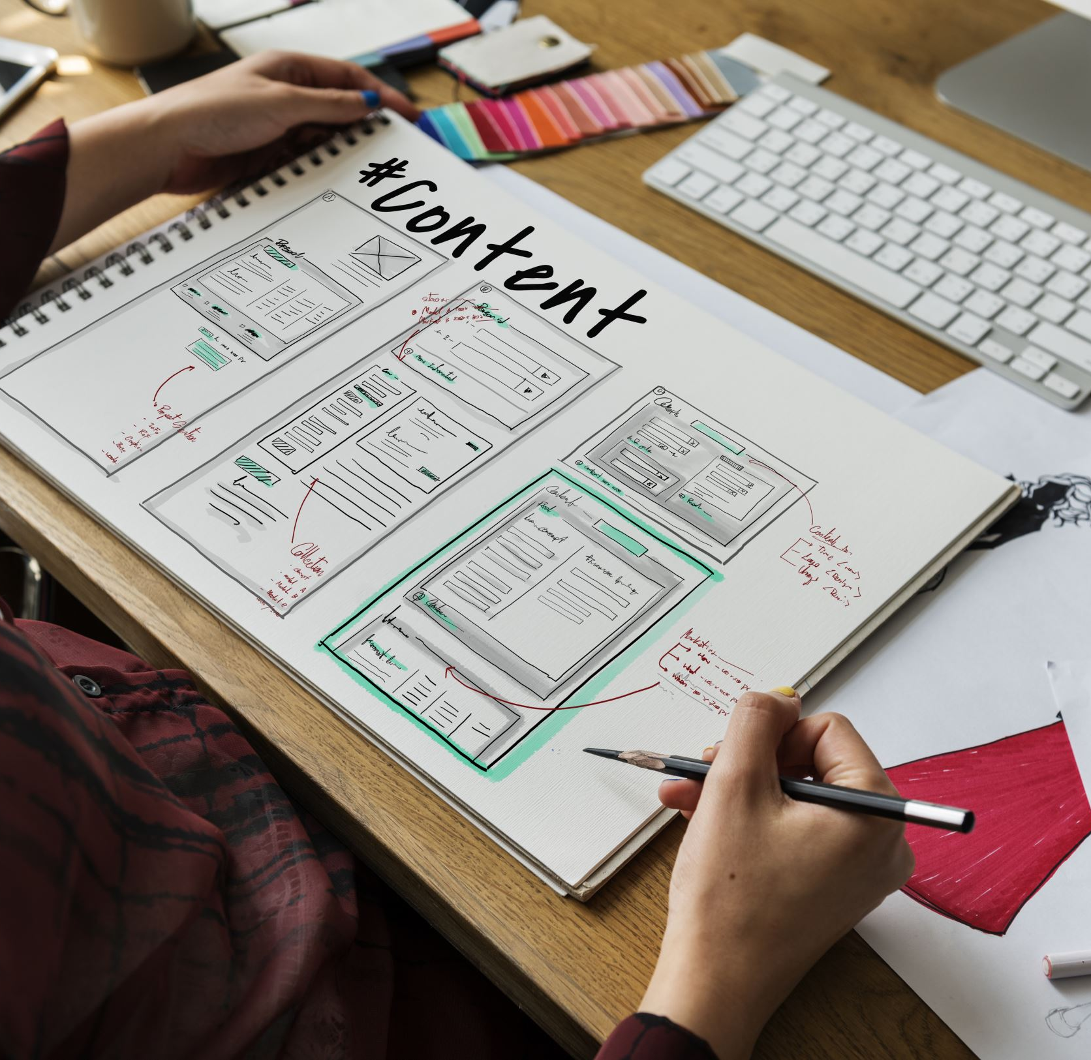
User-Interface Design

Slide 28
Concept
The CLI design will be very simplistic and feature text prompts with number selection for menu navigation.
The GUI will be a fully featured application with a dark theme for eye comfort. The color scheme will be dark gray, and green for contrast to highlight important elements. It will be very graphical in nature with minimal textual input by the user. A separate more featured design will be created for

Slide 29
CLI / Early Phase
The main menu will present options
Each section will prompt the user with numbered options to navigate
Input validation will be implemented to prevent errors
Main Menu
Login
Register
Select Account Type
User Menu
Brows Selection
List all vehicles
Reserve vehicle by ID
Enter pickup date
Enter dropoff date
Confirm reservation ( Y / N )
Return to previous menu

Slide 30
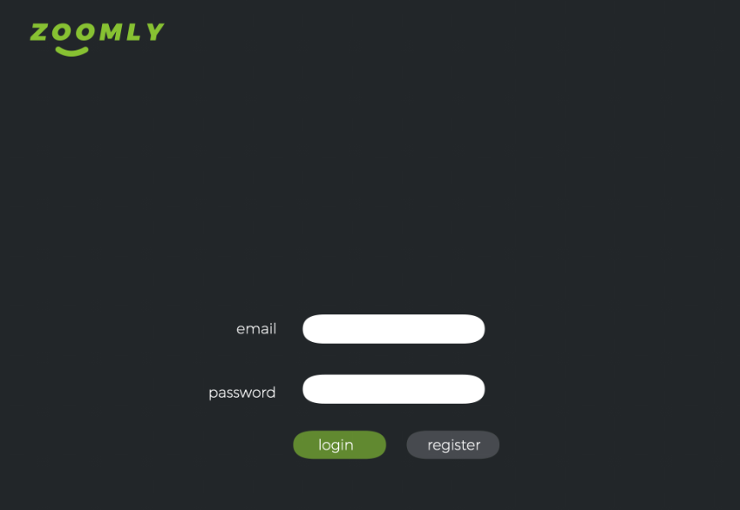

Slide 31
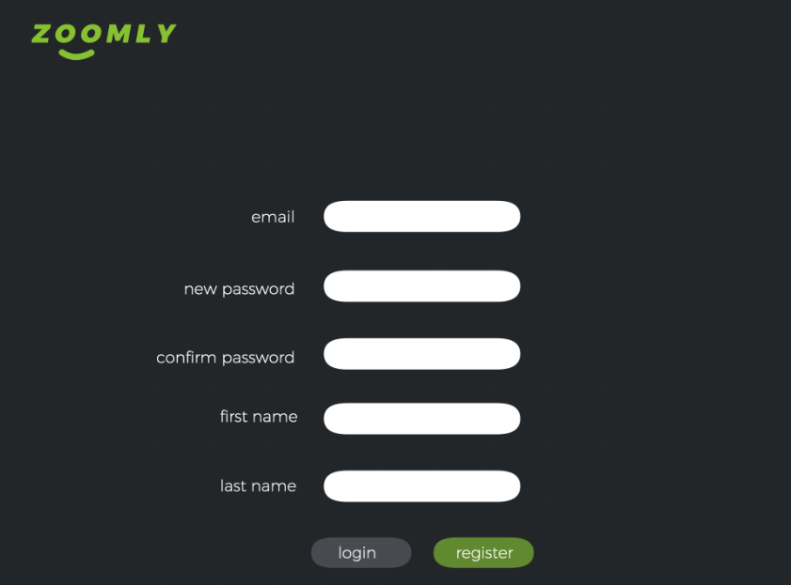

Slide 32
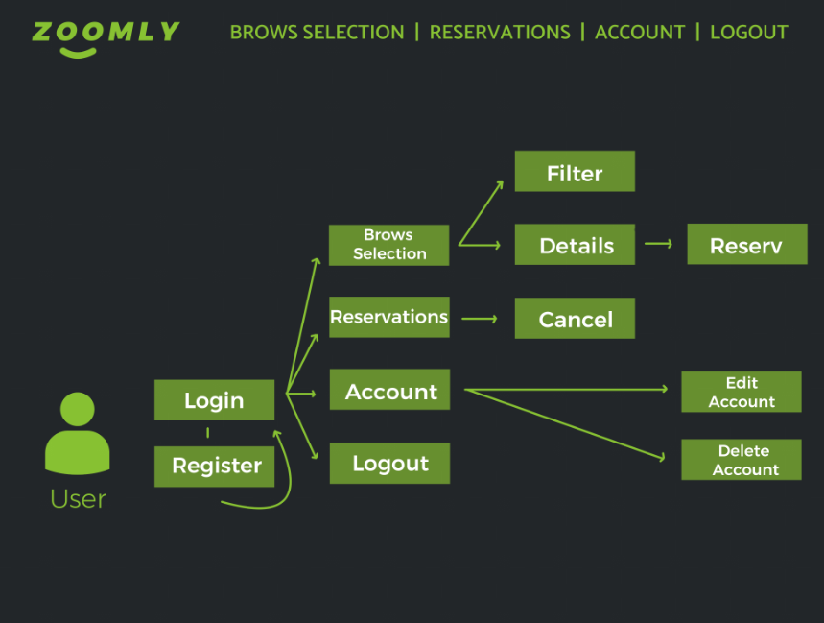

Slide 33
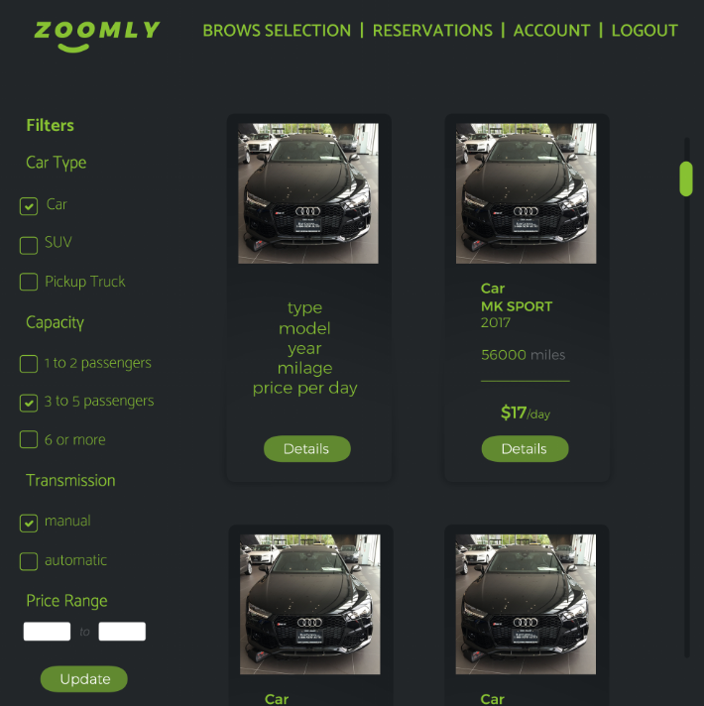

Slide 34
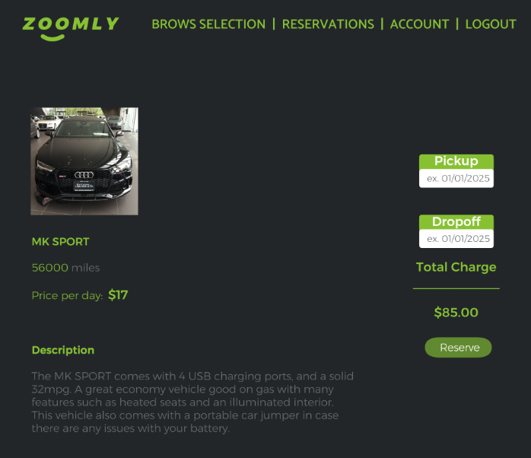

Slide 35
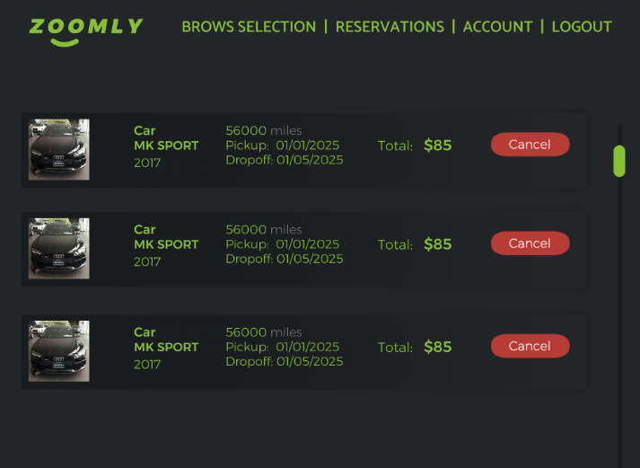

Slide 36
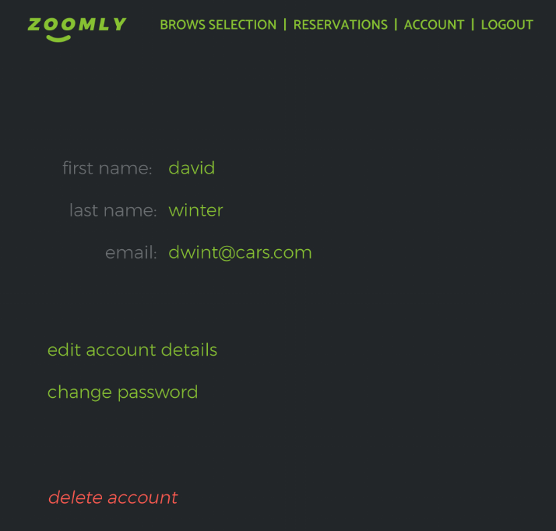

Slide 37
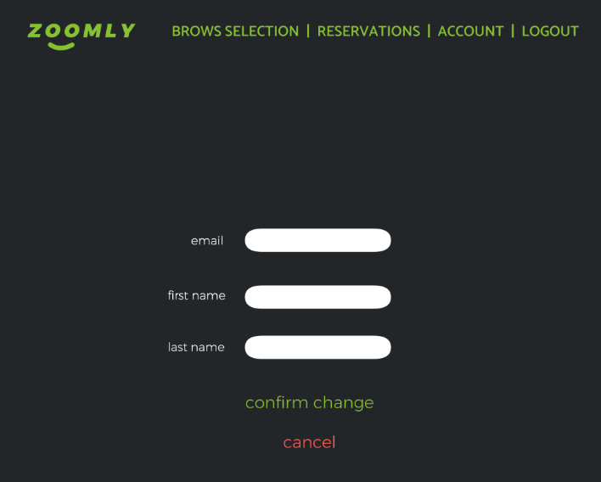

Slide 38
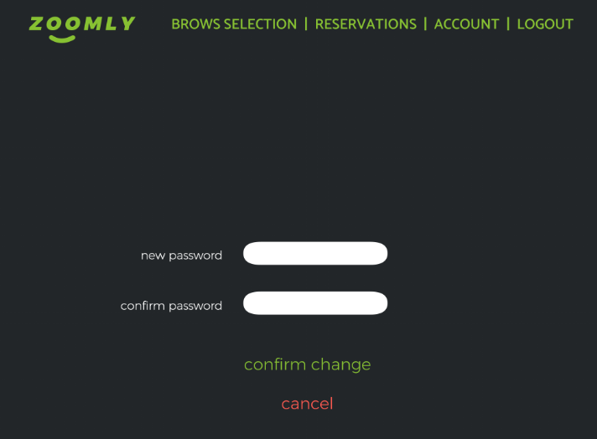

Slide 39
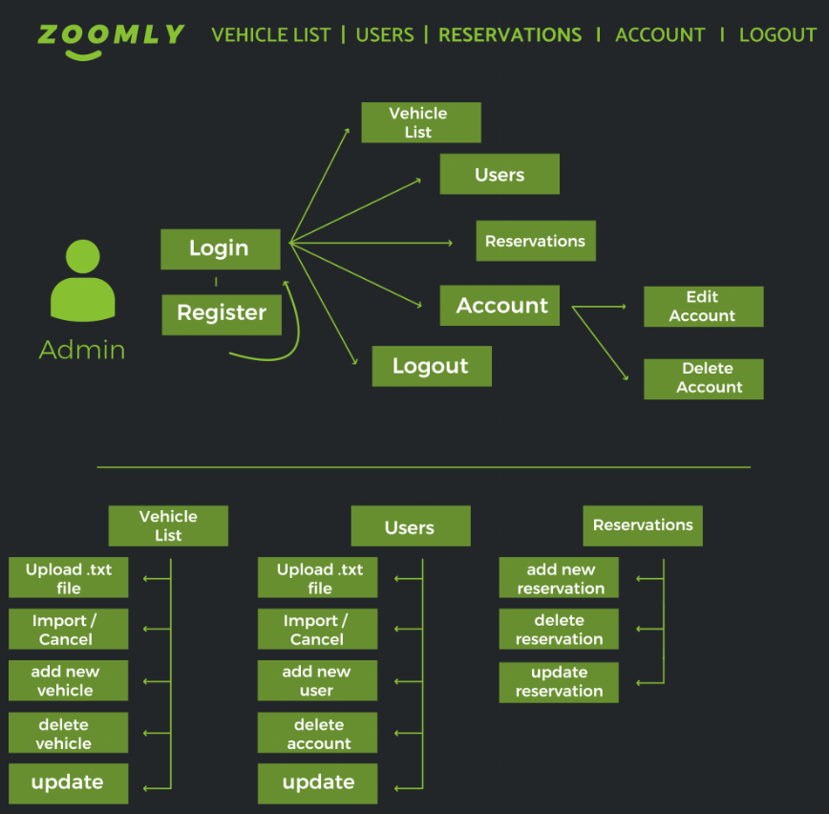

Slide 40
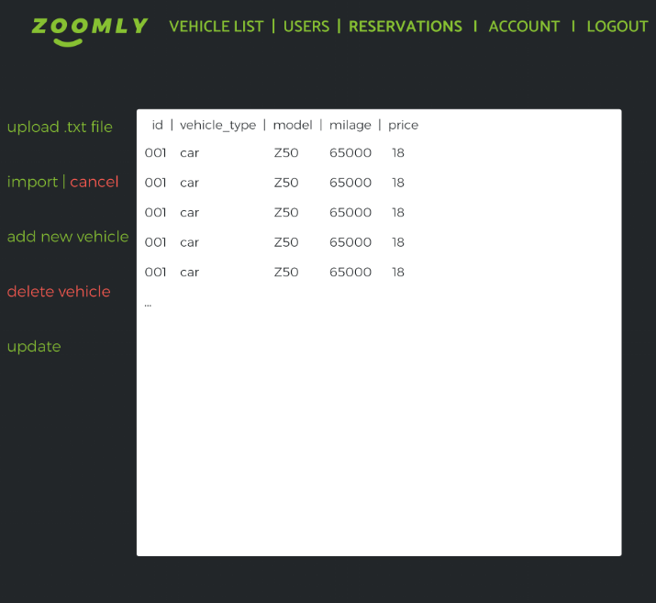

Slide 41
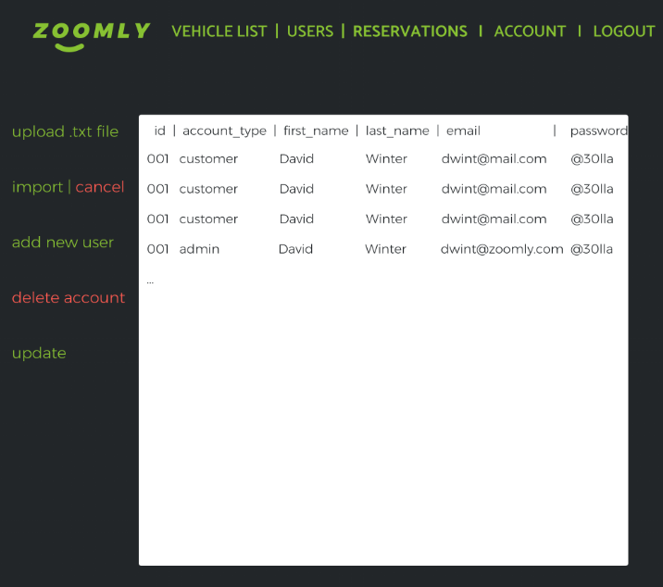

Slide 42
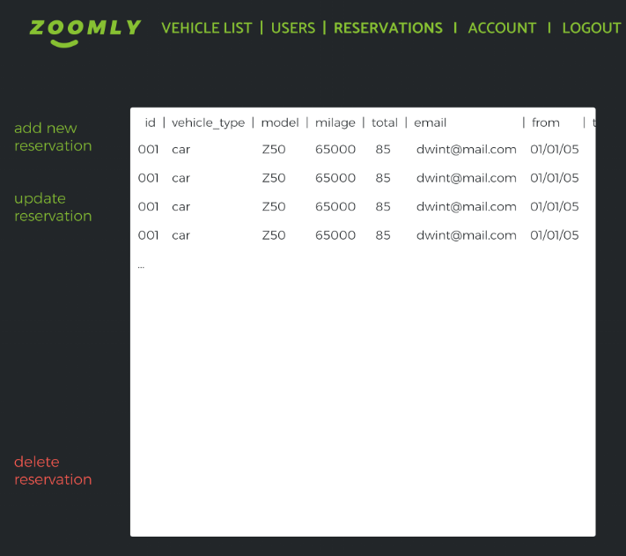

Slide 43
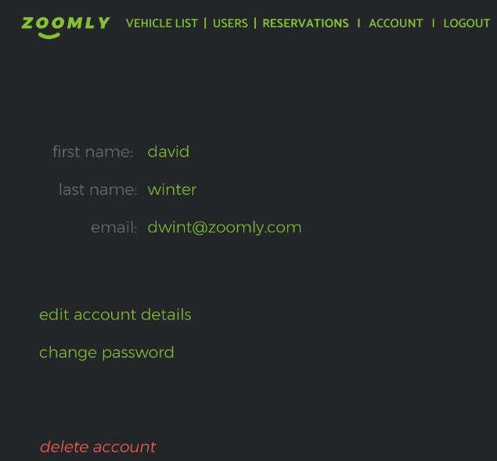

Slide 44
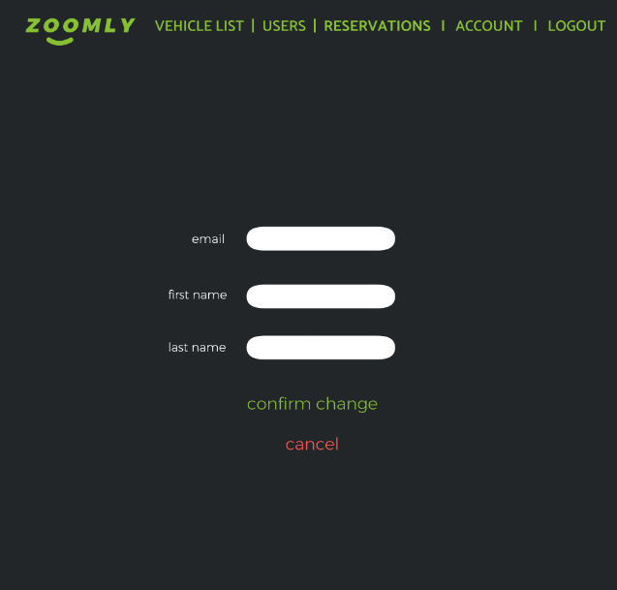

Slide 45
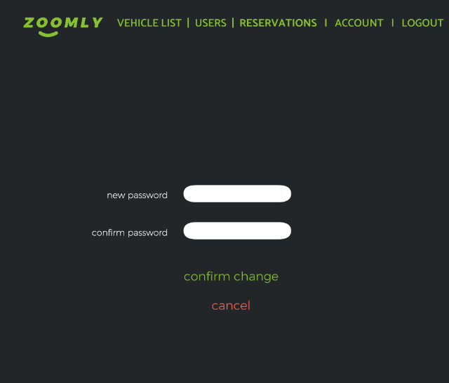

Slide 46

THANK YOU
For your attention!

